Slide 1
Company Clustering and Lookalike Analysis
Groep 2: Ingrid Bol, Marjolein Gerdes, Fabian Wientjes

Slide 2
Business understanding
Goal: Develop a clustering model to group similar companies and create a "lookalike“ identification system.
Use machine learning techniques (e.g., K-means, hierarchical clustering, or better) to group companies based on financial attributes, growth patterns, and industry factors.
● Identify key characteristics of each cluster (e.g., high-growth tech startups, stable manufacturing firms). ● Create a "lookalike" algorithm that can find similar companies given a reference company. ● Incorporate a time dimension to track how companies move between clusters over the years.

Slide 3
Business understanding
Business Value:
Find potential competitors or acquisition targets
Understand common trajectories for companies in different sectors

Slide 4
Hypothesis
Belgian companies can be effectively clustered based on company attributes and industry factors providing a more nuanced understanding of their characteristics and potential.

Slide 5
Data exploration

Slide 6
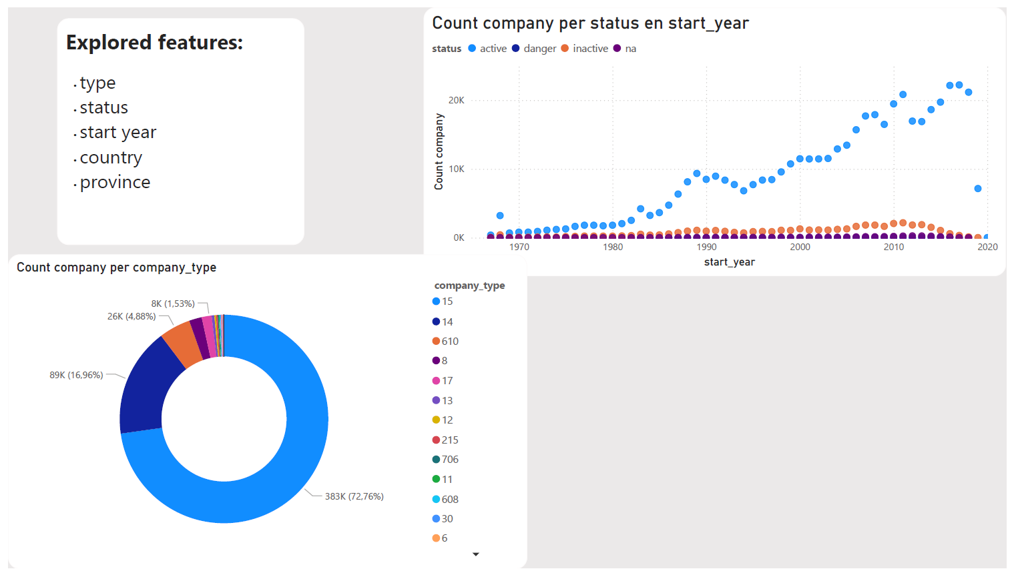

Slide 7
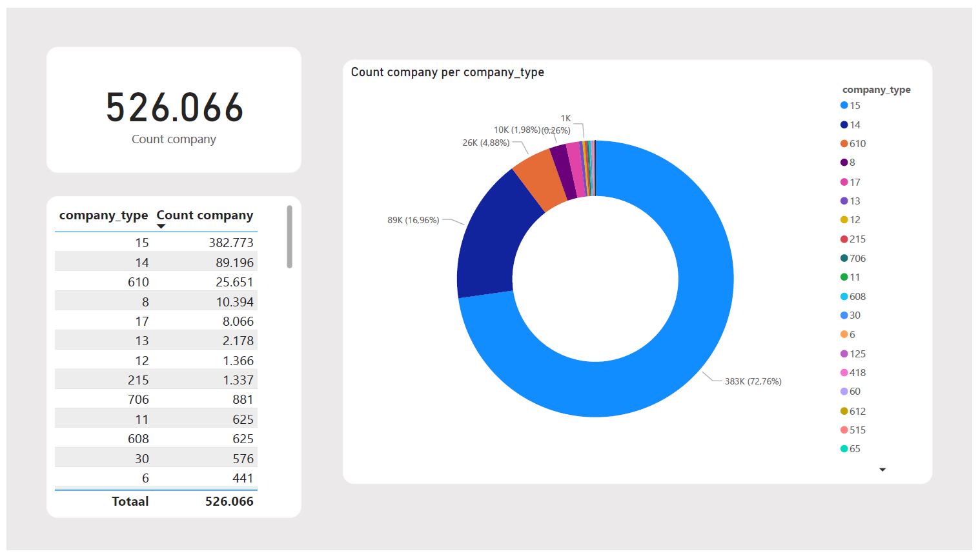

Slide 8
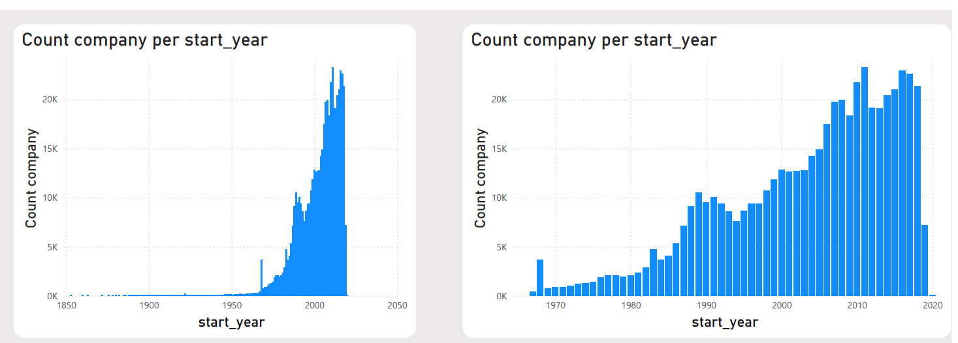

Slide 9
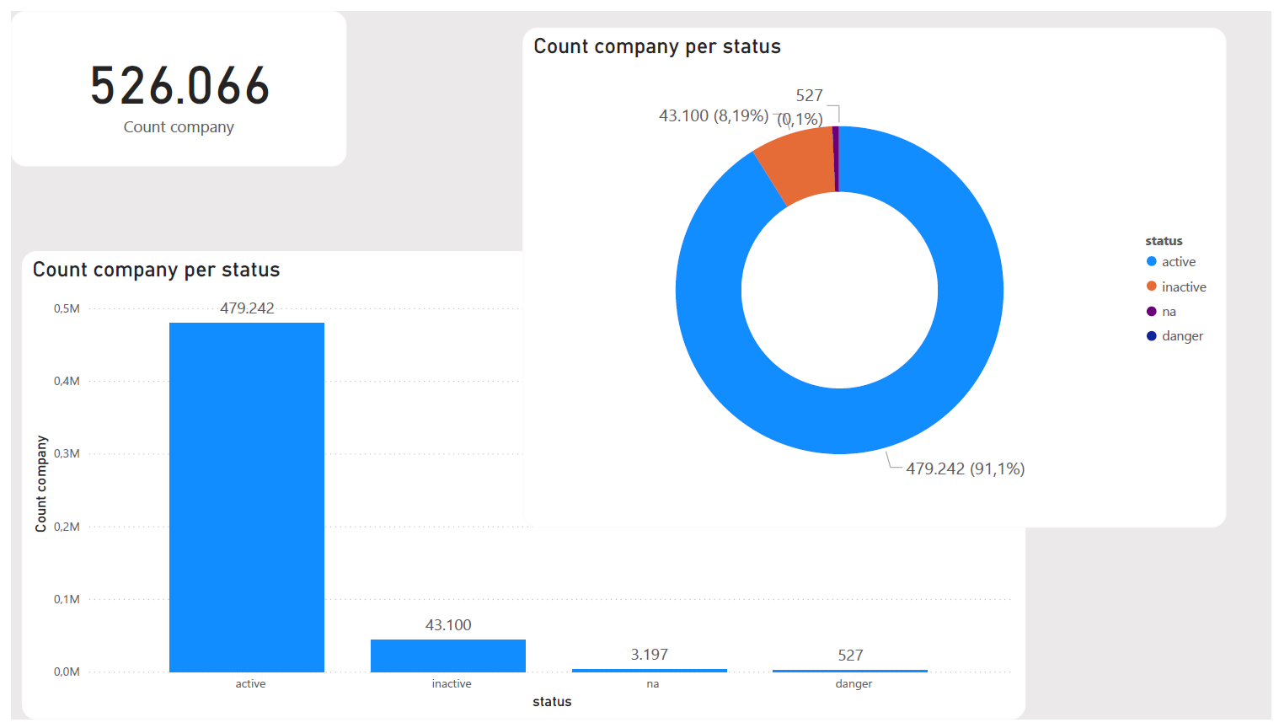

Slide 10
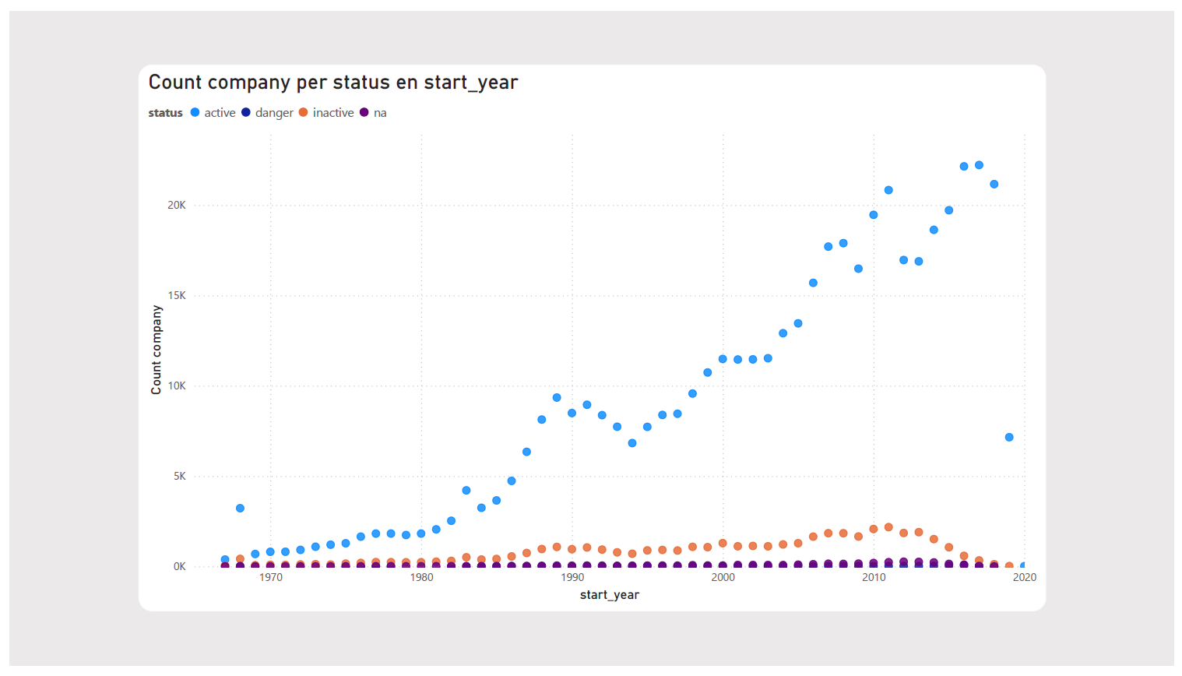

Slide 11
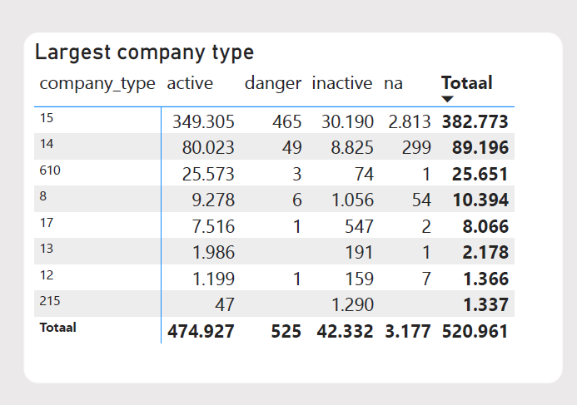

Slide 12
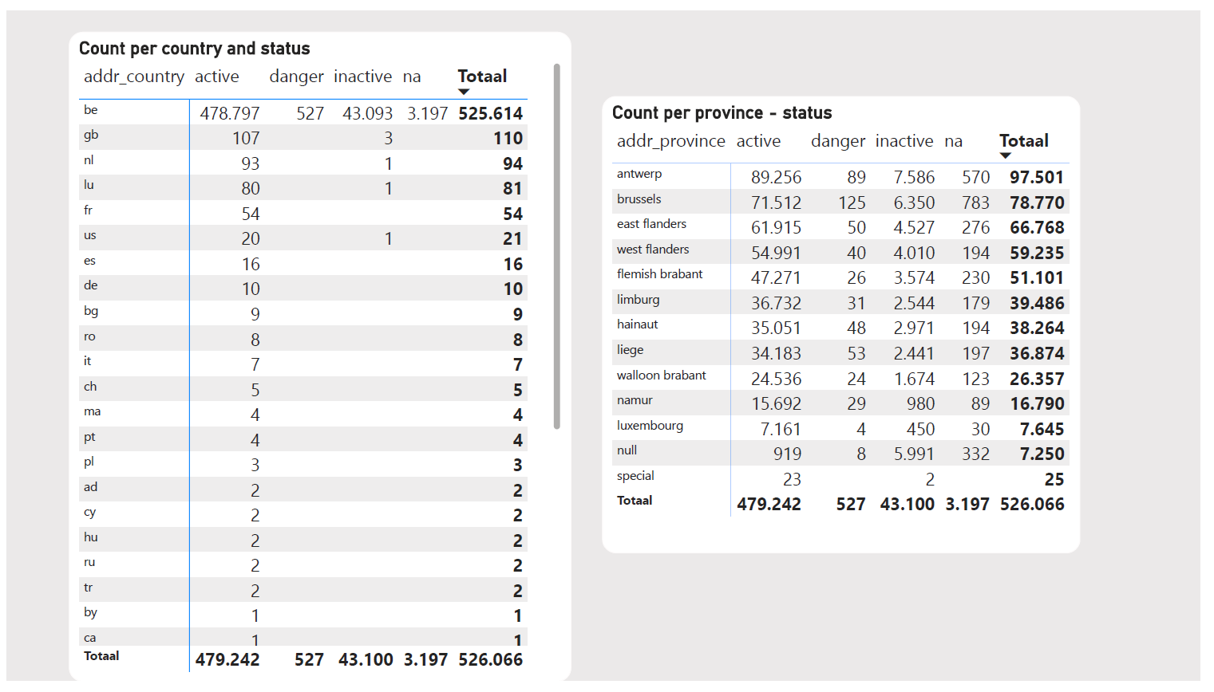

Slide 13
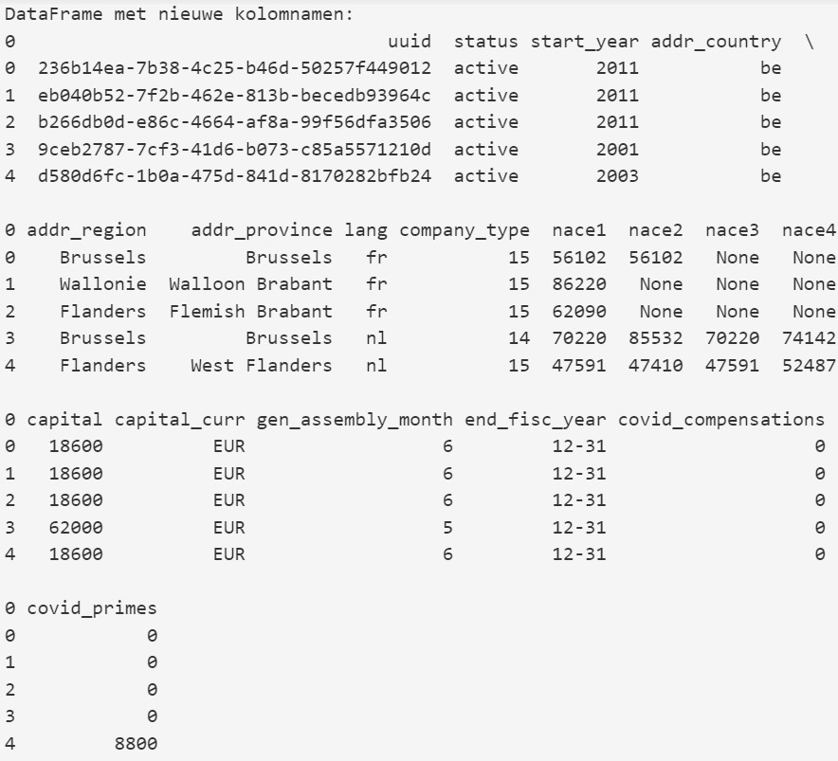
Data understanding & Prep
We only used company_info.json
Make the colomns numeric so they can be used for clustering
Empty fields
Outliers

Slide 14
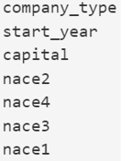
Modeling
K-means clustering
Most common used clustering algorithm

Slide 15
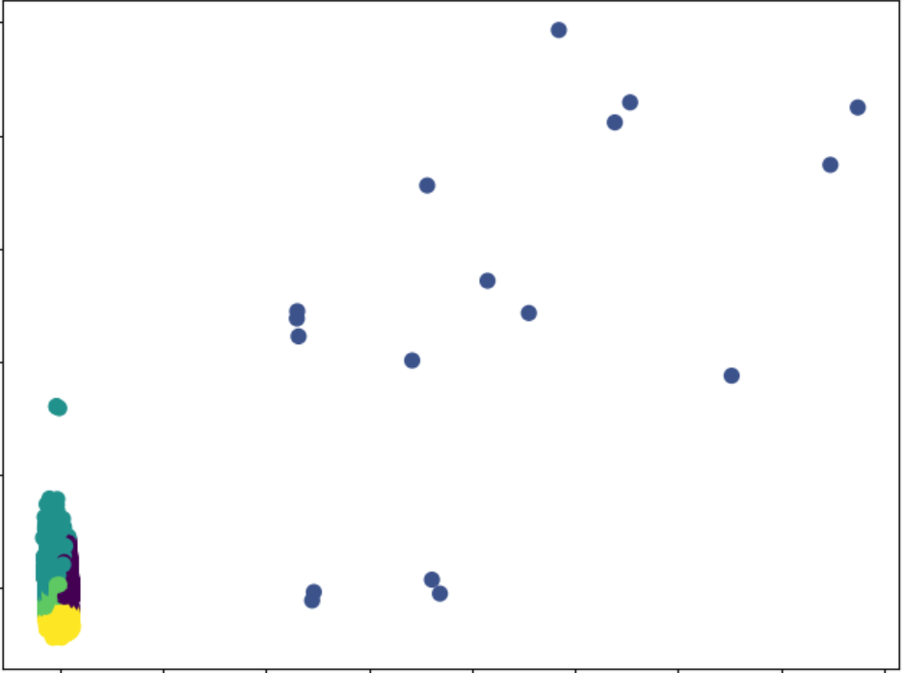
Modeling
With outliers
K-means clustering
Principle component analysis (pca)
Inverse pca

Slide 16
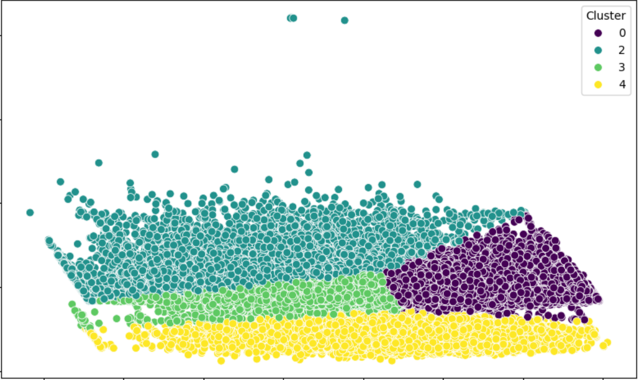
Now without outliers

Slide 17
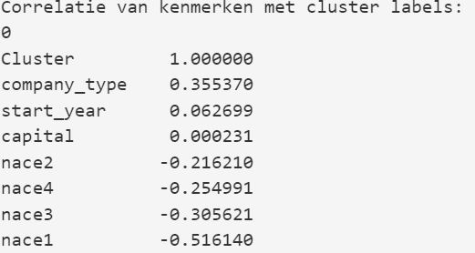
Let’s look at what makes the clusters

Slide 18
Conclusion
It looks like there are 4 clusters (5 with outliers)
The startyear of the company and the initial investment (capital) has very litte correlation with determing an cluster.
Company type is the greatest predictor

Slide 19
Follow-up
Explore finance_info.json if that data brings useful insights for clustering possibilities.
Make all the other columns numeric so they can be used for K-means.
More data cleaning
Many empty fields

Slide 20
Demo

